Slide 1
EMPLOYEE DATABASE MANAGEMENT
GUIDED BY : Prof. P. V .Kothawale
PRESENTED BY : Chavan Vaishnavi Sanjay
Jyothi Hrishikesh Venkatesh
Bavannavar Prathamesh Uday

Slide 2
Abstract:
This report includes a development presentation of an information system for managing the staff data
within a small company or small organization. The system it has been developed is called the employee
management system. It consists of functionally related C program and Database. The mini project on”
employee database management” aims to create a system that can efficiently store and manage employee
data, such as personal details, job related information, and performance evaluations. The system will allow
authorized personnel to access and update employee data, which can help in decision-making and strategic
planning. Overall, this project will provide opportunity to apply theoretical knowledge to a practical
scenario and develop valuable technical and management skills.

Slide 3
Introduction:
This report includes a development presentation of an information system for managing the staff data within a small company or small organization. The system it has been developed is called the employee management system. It consist of functionally related C program and Database.
The Employee Database Management System (EDMS) is an essential tool for organizations to efficiently manage their employee information, streamline HR processes, and ensure the smooth functioning of their workforce. In today's fast-paced business environment, where organizations constantly face the challenges of maintaining accurate and up-to-date employee records, an effective EDMS plays a vital role in simplifying these tasks and providing valuable insights for strategic decision-making.
The purpose of this report is to provide an overview of the Employee Database Management System and its significance in modern organizations. It will outline the key features, benefits, and potential challenges associated with implementing an EDMS. Furthermore, the report will discuss the impact of the system on various HR processes, including employee onboarding, performance evaluation, training and development, and compliance management.

Slide 4
Purpose:
Objectives:
Design methodology:
The purpose of this presentation is to develop and c program for maintaining and employee database.
To provide an overview of the program and what it does, and the functionality of the program in brief.
Implementing the c language create and program for management of employee database.

Slide 5
System architecture:
DATA STORAGE
USER INTERFACE
DATA ACCESS LAYER
BUSINESS LOGIC LAYER
SECURITY
REPORTING

Slide 6
Research gap
Employee management system: To create such a system we need to focus on many aspect such as employee information management ,attendance tracking, payroll management ,performance evaluation, and scheduling.
Database management system: when creating such and database we need to focus on this aspect such as, scalability, security , performance, and ease to use. As well as specific needs of organization, such as size and types of employee data.
Data structure: It is essential to create and bank of data structure for this type of management system , This include function such as , Employee table , Department table , Indexes , Linked lists, Binary Tree, This are some of the main function to be used in this management system.
Programming: While programing in c , you would need write code to perform various task such as, adding, updating, and deleting employee record, generating reports. This functions and task can only be performed such a type of c functions which are as follow, structs, file I/O, pointers, searching and sorting algorithms error handling.

Slide 7
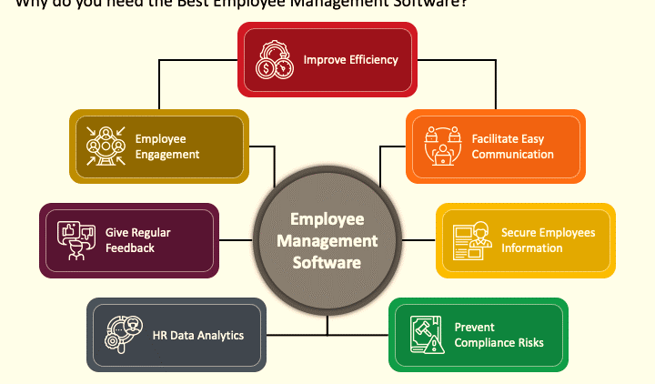

Slide 8
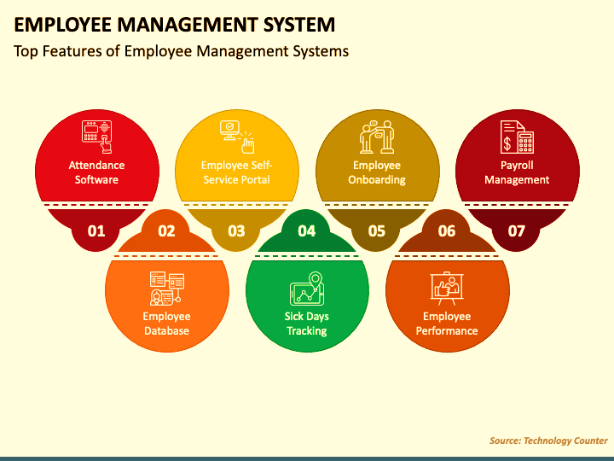
Features of system

Slide 9
Objectives:
1.Efficiency store and manage employee-related information.
2.Keep track of personal details, job roles , salaries, work hours, attendance records , salaries , etc.
3.Ensure data accuracy and security.
4.Simplify the process of the data management .

Slide 10
Result analysis:
Data Accuracy: The employee database management system should accurately store and maintain employee information.
Timelessness : The system should be able to update employee information in a timely manner.
User-friendliness: The system should be easy to use for the HR and business software , such a payroll or scheduling systems.
Performance: This system should be able to handle large volumes of data and quires quickly and efficiently.
Integration: this system should be integrated with the other management staff such as HR and business software.

Slide 11
Methodology:
The process begins with defining the objectives and scope of the database, followed by determining the
necessary data fields and designing an appropriate database scheme.
Data collection methods may include:
Manual entry.
Automated systems.
Data validation.
Ensure accuracy and consistency.

Slide 12
Requirement Specifications:
Hardware Requirements:-
PC or Laptop.
PROCESSOR- Intel Core i3.
RAM- 8.00 GB.
Software Requirements:-
OS- Windows 11.
CODE EDITOR- DEV C++, Ubuntu, Visual Studio.

